Slide 1

Computer Science 212 Introduction to Programming for Analysts
Deep Learning

Slide 2
Lesson Objectives
By the end of this lesson, you will be able to:
Explain the advantages and disadvantages of Deep Learning compared to other Machine Learning techniques
Summarize what is a Neural Network and its components (Neurons and Layers)

Slide 3
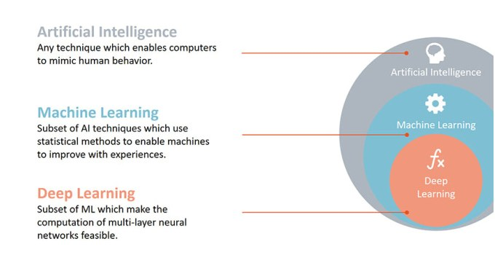
What is Deep Learning?

Slide 4
Why Deep Learning?
Advantages
Ability to attain greater prediction accuracy
Requires less time to test compared to Traditional Machine Learning
No feature engineering!
Disadvantages
Less interpretability
Requires more data to train compared to Traditional Machine Learning
Requires more human interpretability compared to Traditional Machine Learning

Slide 5

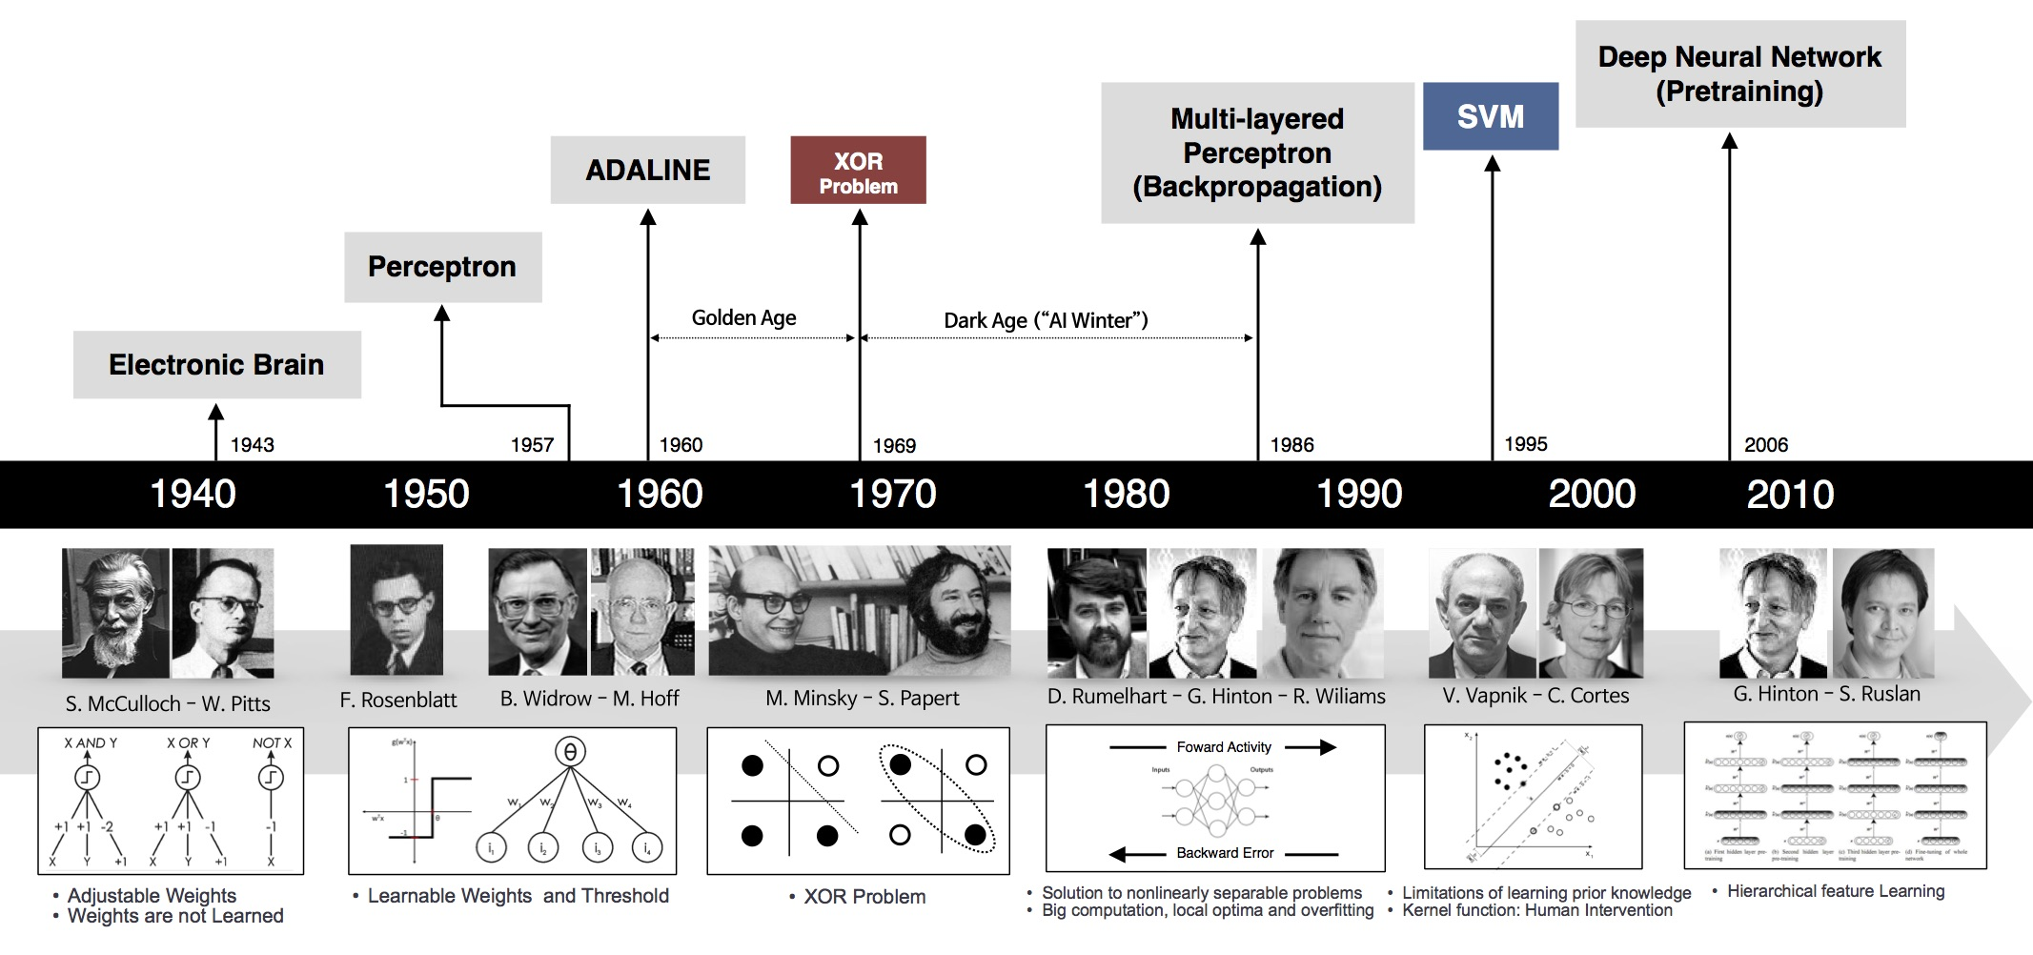
Why Now?
Big Data
Larger Datasets
Easier Collection & Storage
Hardware
Graphics Processing Units (GPUs)
Massively Parallelizable
Software
Improved Techniques
New Models
Toolboxes

Slide 6
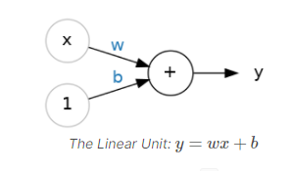
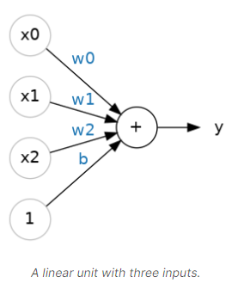
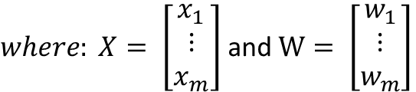

How Does Deep Learning Work?
Same overarching concept as Machine Learning
Use features to make predictions about targets
Neural networks
Composed of neurons, where each neuron individually performs only a simple computation.
Together they provide a full representation of what is being classified
Price = w0 * Sqft +
w1 * #_beds +
b
Price = w * Sqft + b
$$y= X^{T}W+b$$
$where: X= \left[\begin{matrix}x_{1} \\ ⋮ \\ x_{m}\end{matrix}\right]$ and $W= \left[\begin{matrix}w_{1} \\ ⋮ \\ w_{m}\end{matrix}\right]$

Slide 7
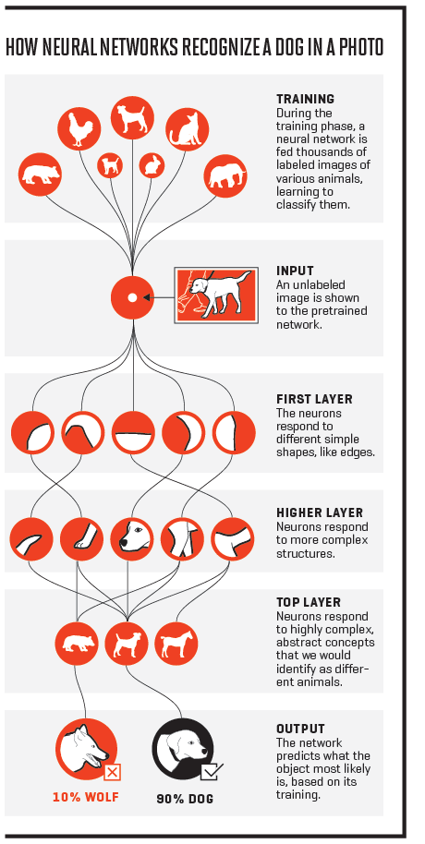

How Does Deep Learning Work?
Life is not always simple and linear! !!
Simple Non-Linear
Complex Spiral
$$y= {g(X}^{T}W+b)$$

Slide 8
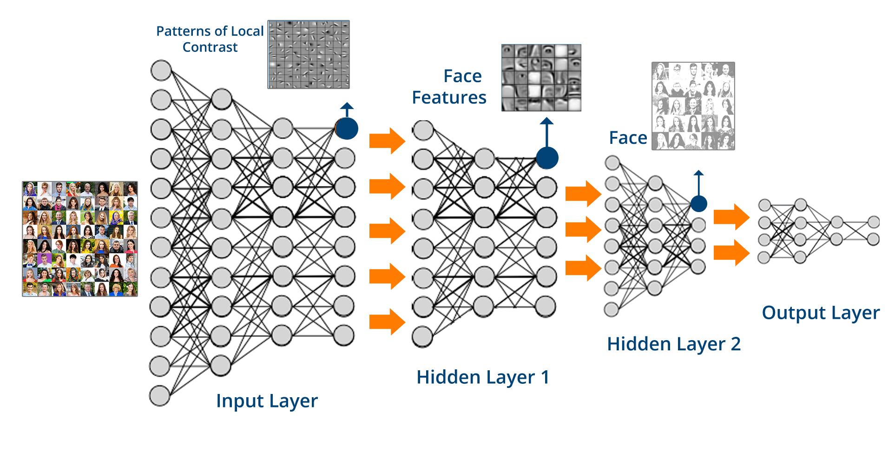
Deep Learning Example

Slide 9
Lesson Review
How do I know that you learned? It’s because you can now:
Explain the advantages and disadvantages of Deep Learning compared to other Machine Learning techniques
Summarize what is a Neural Network and its components (Neurons and Layers)

